Slide 1
KOSIM: A Knowledge-oriented Derivative-free Subspace Method Based on Inexact Model for Inverse Lithography Problems
Presenter : Min-Feng Hsieh
Advisor : Ting-Chi Wang

Slide 2
Outline
Introduction
Preliminaries
Algorithm
Experimental Result
Conclusion

Slide 3
Outline
Introduction
Preliminaries
Algorithm
Experimental Result
Conclusion

Slide 4
Introduction
Optical lithography (光學微影技術)
將曝光光源通過設計過的光罩，光罩上面即具有各種圖案可以阻擋或讓光穿透過去。
若光打到正光阻上，該處會被蝕刻; 若是負光阻的話相反。
是製造集成電路（IC）和其他半導體設備的主要工藝之一
將微細的電子元件、晶體管、電容器等結構準確地印刷在半導體材料上

Slide 5
Introduction
Due to the tiny scale of circuit device size, the influence of interference and diffraction will distort the image on the wafer very much.
Lots of works are proposed to resolve this kind of distortion:
Optical proximity correction (OPC) 光學接近校正
Notes:
干涉和繞射的影響

Slide 6
Introduction
Optical proximity correction (OPC)
Adjust the mask layout such that the output pattern approximates the target.
Discrete the mask into the matrix, and use the pixel-wise imaging function to characterize the imaging procedure.
OPC process is model as an inverse problem, and is also called as inverse lithography techniques (ILT).
Inverse problem is formulated as the non-convex optimization problem with respect to the matrix elements.
Notes:
imaging procedure: 成像過程

Slide 7
Introduction
To solve ILT:
Approximate forward imaging modeling
Computation of forward imaging may need numerical simulations.
Consider the imaging function as lacking gradient, and develop general DFO method.

Slide 8
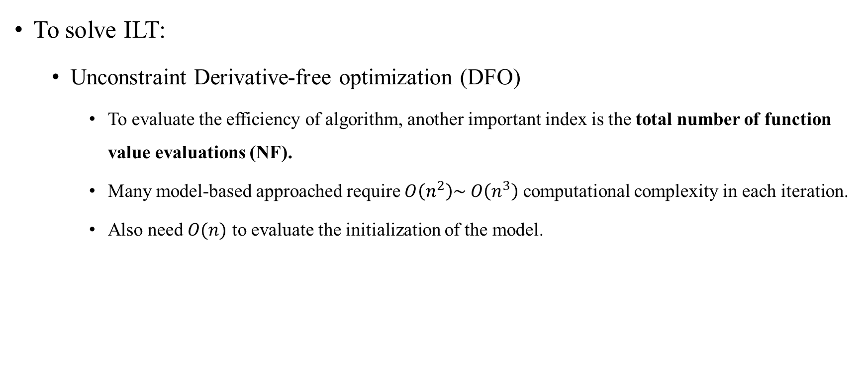
Introduction
To solve ILT:
Unconstraint Derivative-free optimization (DFO)
To evaluate the efficiency of algorithm, another important index is the total number of function value evaluations (NF).
Many model-based approached require $O\left(n^{2}\right)\sim O\left(n^{3}\right)$ computational complexity in each iteration.
Also need $O(n)$ to evaluate the initialization of the model.

Slide 9
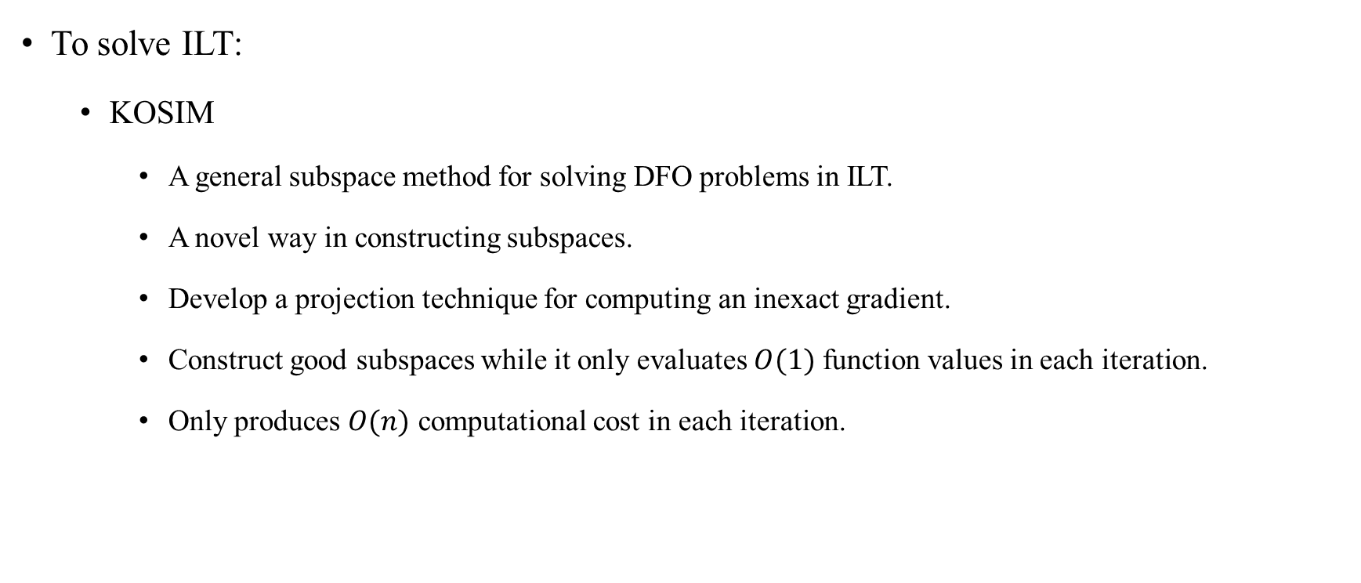
Introduction
To solve ILT:
KOSIM
A general subspace method for solving DFO problems in ILT.
A novel way in constructing subspaces.
Develop a projection technique for computing an inexact gradient.
Construct good subspaces while it only evaluates $O(1)$ function values in each iteration.
Only produces $O(n)$ computational cost in each iteration.

Slide 10
Outline
Introduction
Preliminaries
Algorithm
Experimental Result
Conclusion

Slide 11
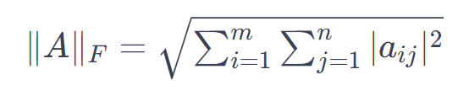
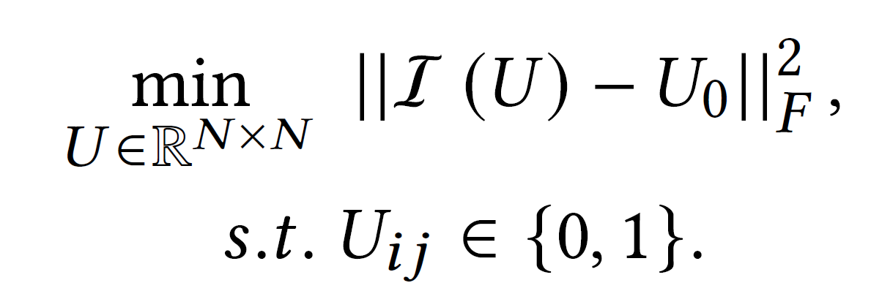
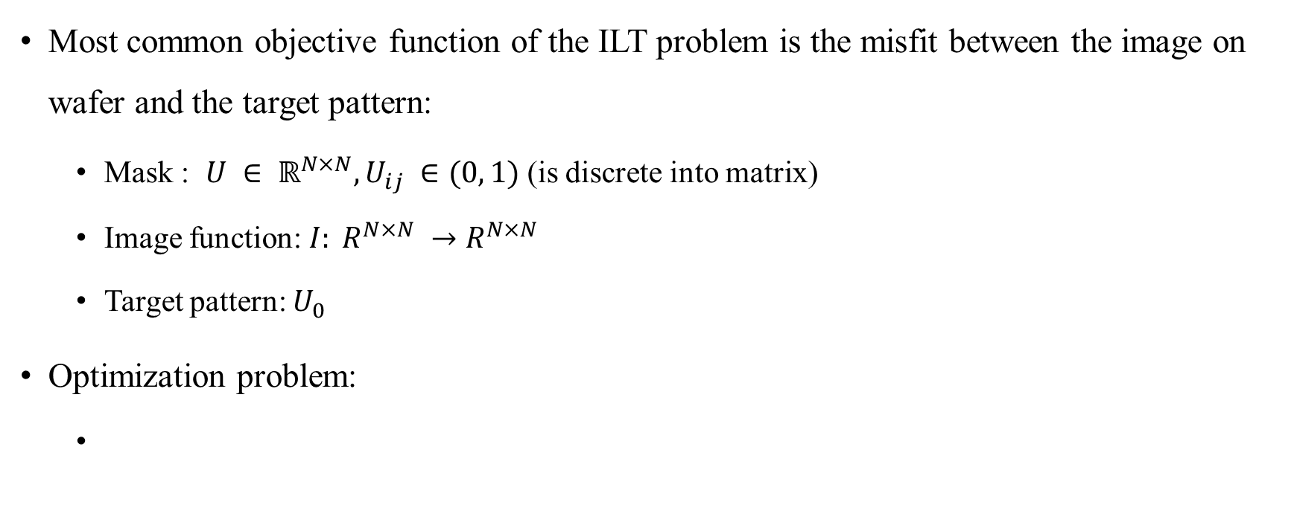
Preliminaries
Most common objective function of the ILT problem is the misfit between the image on wafer and the target pattern:
Mask : $U ∈ ℝ^{N×N}, U_{ij} ∈(0, 1)$ (is discrete into matrix)
Image function: $I: R^{N×N} →R^{N×N}$
Target pattern: $U_{0}$
Optimization problem:

Slide 12
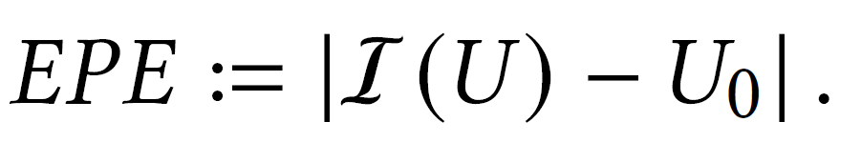
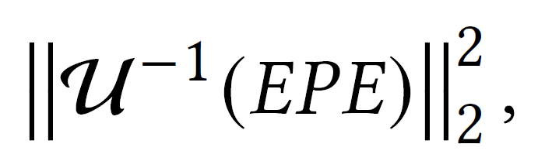
Preliminaries
Optimization problem:
Edge placement error (EPE)
𝐿2 square error
Notes:
square of 𝐿2 norm of the vectorized EPE

Slide 13
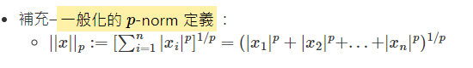

Slide 14
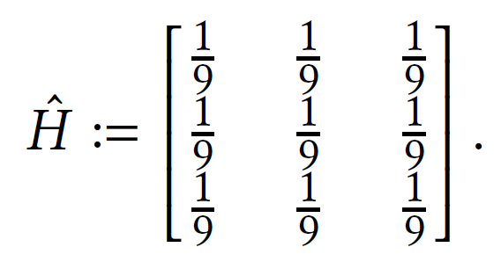
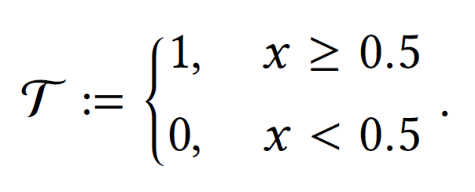
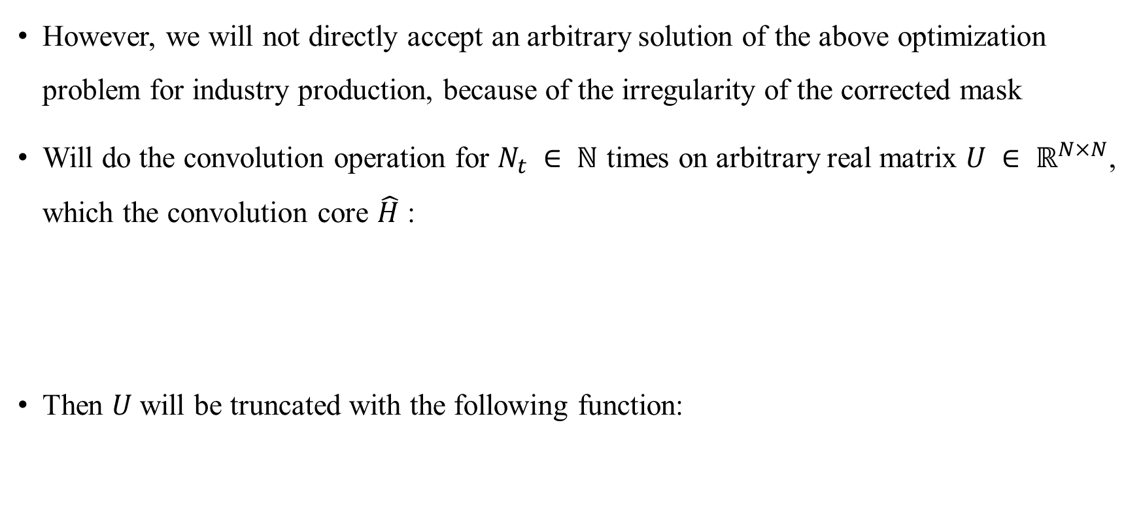
Preliminaries
However, we will not directly accept an arbitrary solution of the above optimization problem for industry production, because of the irregularity of the corrected mask
Will do the convolution operation for $N_{t} ∈ ℕ$ times on arbitrary real matrix $U ∈ ℝ^{N×N}$, which the convolution core $\hat{H}$ :
Then $U$ will be truncated with the following function:
Notes:
會對U與H進行卷積，並做Nt次

Slide 15
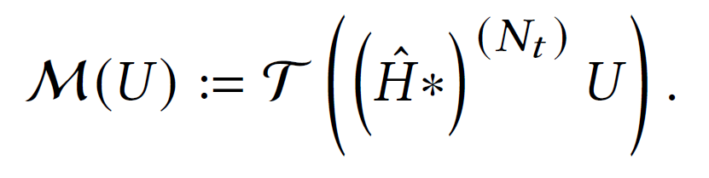
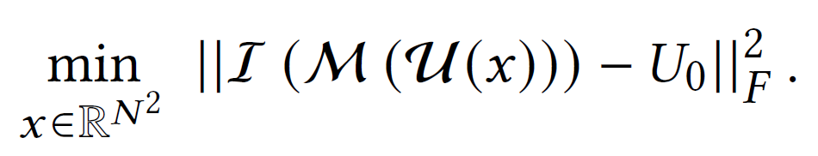
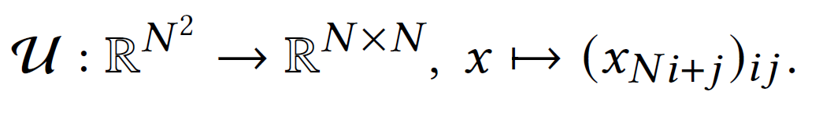

Preliminaries
We define the previous operation (convolution and truncation) as $M: ℝ^{N×N} →ℝ^{N×N}$ :
Thus the modified optimization problem becomes:
Where the matrization operator:
Notes:
會對U與H進行卷積，並做Nt次 (不是矩陣運算，所以dimension不需要對到)

Slide 16
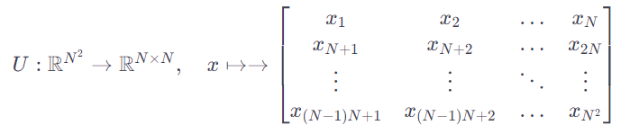
Preliminaries

Slide 17
Outline
Introduction
Preliminaries
Algorithm
Experimental Result
Conclusion

Slide 18
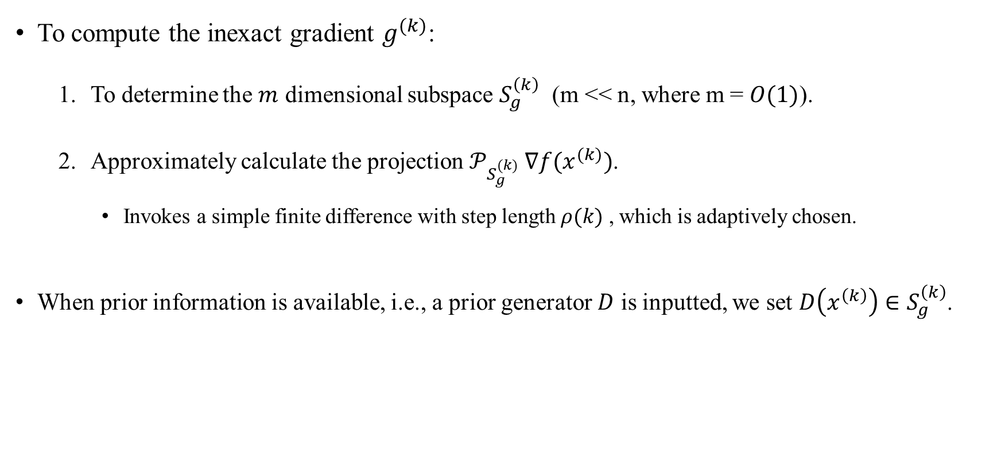
Algorithm - knowledge-oriented inexact gradient
To compute the inexact gradient $g^{(k)}$:
To determine the $m$ dimensional subspace $S_{g}^{\left(k\right)}$ (m << n, where m = $O(1)$).
Approximately calculate the projection $𝒫_{S_{g}^{(k)}} ∇f(x^{(k)})$.
Invokes a simple finite difference with step length $ρ(k)$ , which is adaptively chosen.
When prior information is available, i.e., a prior generator $D$ is inputted, we set $D\left(x^{\left(k\right)}\right)∈S_{g}^{\left(k\right)}$.
Notes:
這裡的 \(𝑛\) 表示原始問題的參數維度
简而言之，这段文本描述了一种使用子空间投影来近似计算梯度的方法，并且当有先前信息可用时，利用该信息来设置子空间。
* 對於 PS(𝑘)𝑔∇𝑓（𝑥(𝑘)）的近似計算，我們使用了一個帶有適應性選擇的簡單有限差分，其步長為 𝜌(𝑘)。
當有先前的信息可用時，即有一個先前的生成器 D 輸入時，我們設定 D（𝑥(𝑘)） ∈ S(𝑘)𝑔。

Slide 19
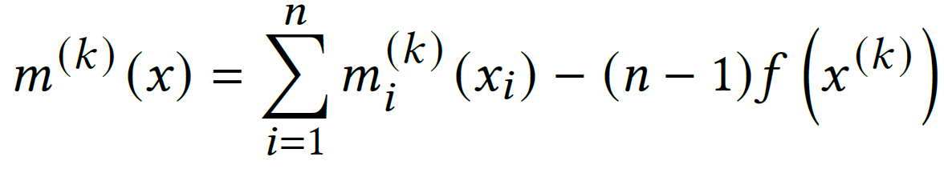
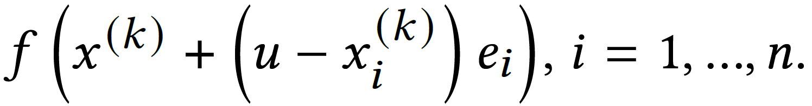
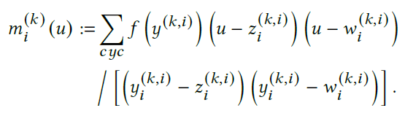
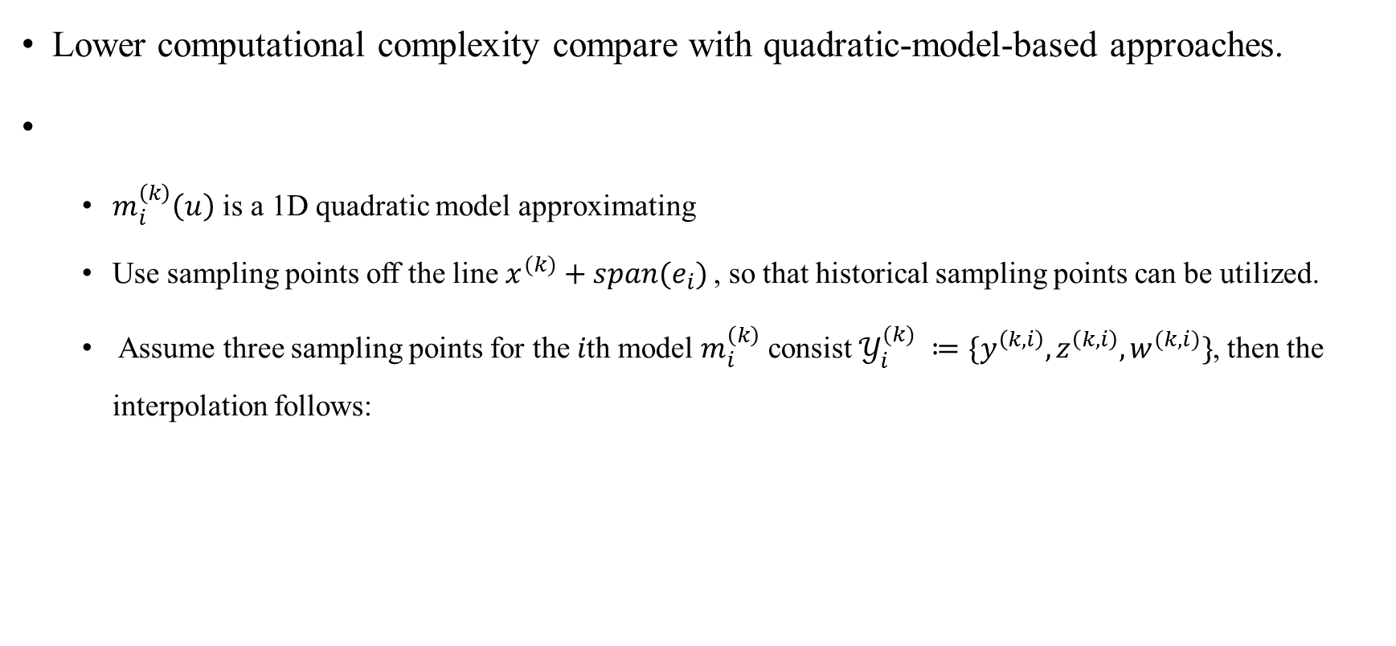
Algorithm - Separable quadratic inexact model
Lower computational complexity compare with quadratic-model-based approaches.
$m_{i}^{\left(k\right)}\left(u\right)$ is a 1D quadratic model approximating
Use sampling points off the line $x^{(k)}+span(e_{i})$, so that historical sampling points can be utilized.
Assume three sampling points for the 𝑖th model $m_{i}^{\left(k\right)}$ consist $𝒴_{i}^{(k)} ≔\{y^{\left(k,i\right)}, z^{\left(k,i\right)}, w^{(k,i)}\}$, then the interpolation follows:
Notes:
構建 m(𝑘)_𝑖 (model is linear)的直觀想法是在 \(𝑥 (𝑘) + \text{span}(\mathbf{e}_𝑖)\) 上使用三個採樣點進行插值，以逼近 \(f\)。然而，這將導致 O(𝑛) 的函數值評估成本。為了更經濟，考慮在離開線 \(𝑥 (𝑘) + \text{span}(\mathbf{e}_𝑖)\) 的點上進行採樣，以便可以利用歷史採樣點

Slide 20
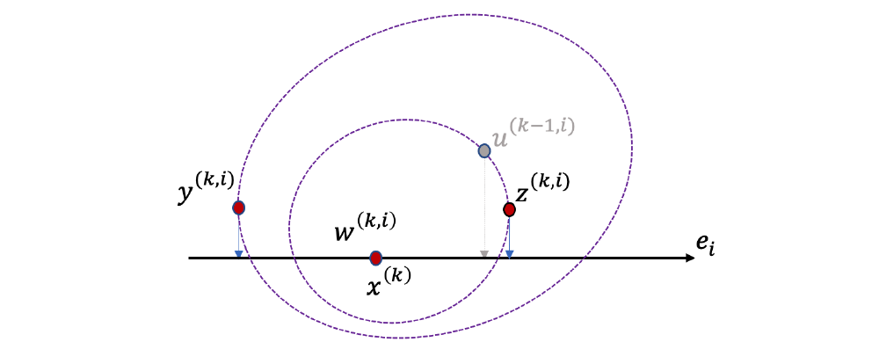
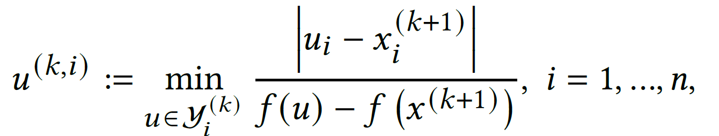

Algorithm - Detail
Initializing and Updating the sampling points
$y^{(0,i)}= z^{(0,i)}= w^{(0,i)} ≔ x^{\left(0\right)}+\left(i−2\right)r1, i=1, 2, 3$
$r$ is an arbitrary parameter where $r>0$.
$1=[1, 1, 1, …, 1]^{T}$.
After an iteration, we will get $x^{(k+1)}$, and update one of the sampling points $u^{(k,i)}$ in $𝒴_{i}^{\left(k\right)}$
$𝒴_{i}^{\left(k\right)}$ will be updated to $𝒴_{i}^{\left(k+1\right)}$
Notes:
連接上一個投影片
其中 𝑢(𝑘,𝑖) 是在 Y(𝑘) 中使得梯度方向与 𝑒𝑖 （标准基向量）更为平行的采样点。

Slide 21
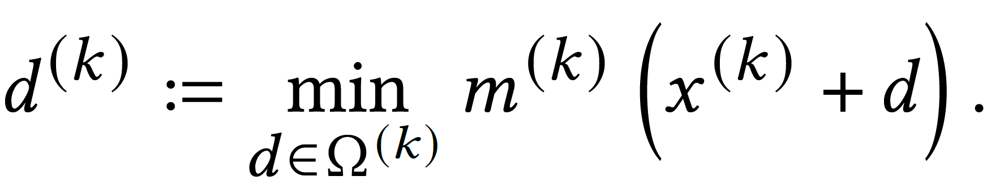
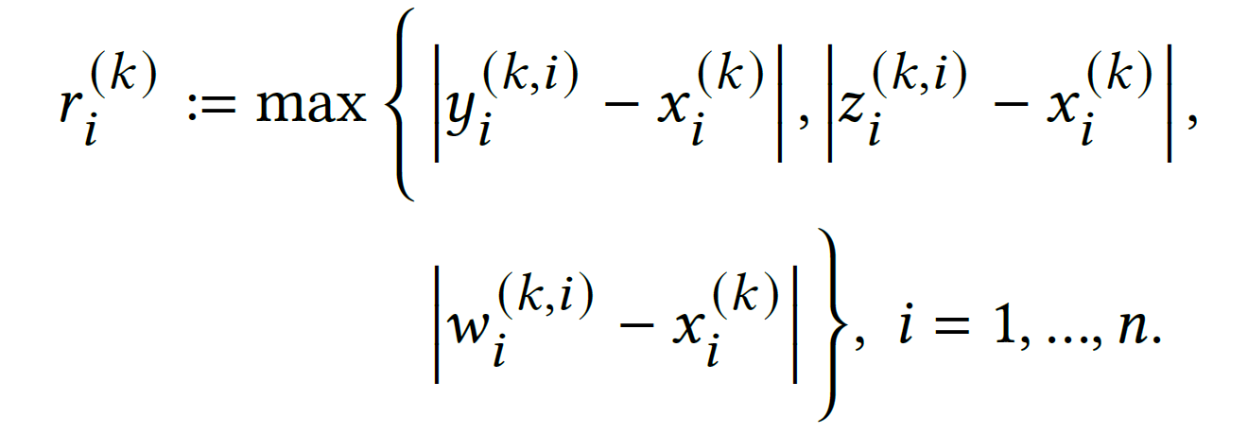
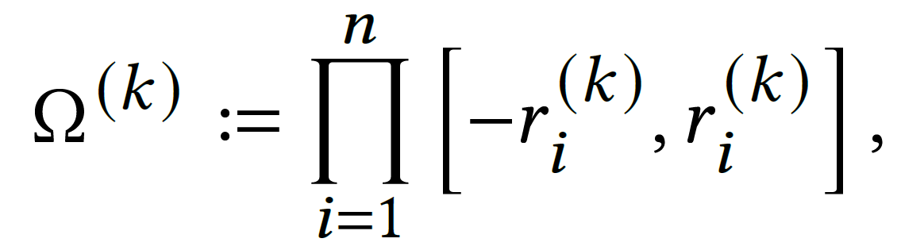

Algorithm - Detail
Solving the model
The direction of the model
Box region $Ω^{(k)}$

Slide 22
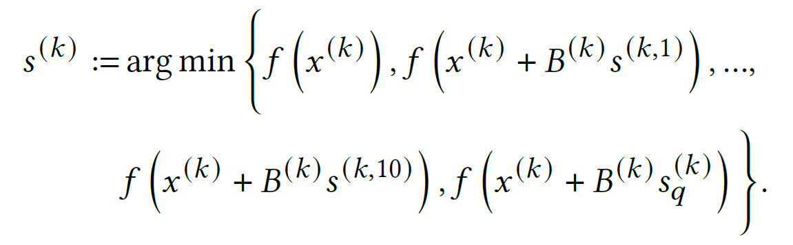
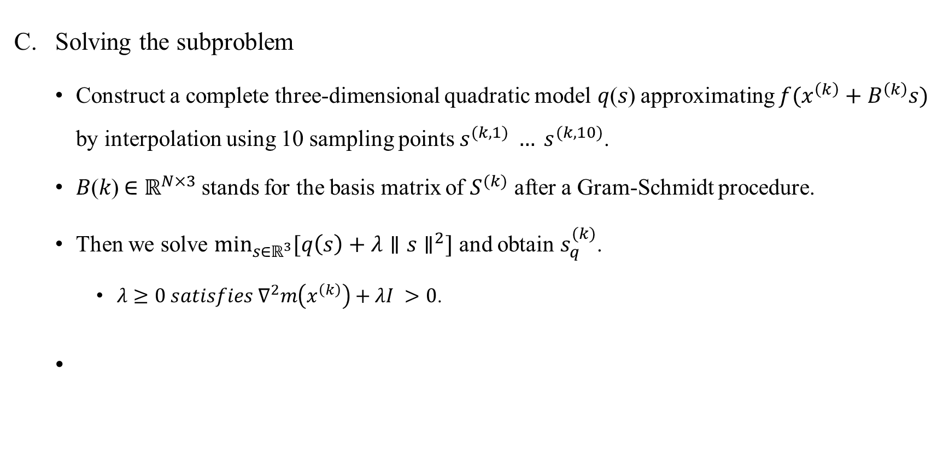
Algorithm - Detail
Solving the subproblem
Construct a complete three-dimensional quadratic model 𝑞(𝑠) approximating $f(x^{\left(k\right)}+B^{\left(k\right)}s)$ by interpolation using 10 sampling points $s^{(k,1)} … s^{(k,10)}$.
𝐵(𝑘) ∈ $ℝ^{N×3}$stands for the basis matrix of $S^{(k)}$ after a Gram-Schmidt procedure.
Then we solve $\min_{s∈ℝ^{3}}{[q\left(s\right)+λ∥s∥^{2}]}$ and obtain $s_{q}^{(k)}$.
$λ≥0 satisfies ∇^{2}m\left(x^{\left(k\right)}\right)+λI >0$.

Slide 23
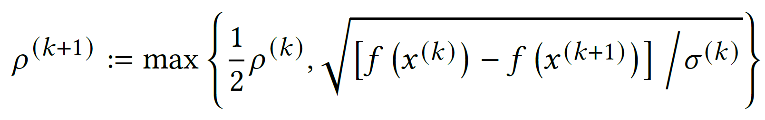
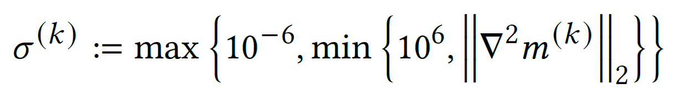

Algorithm - Detail
Updating the finite-difference step length
For updating the finite difference step length $ρ^{(k)}$ , we choose a scaling factor $σ^{\left(k\right)}$ > 0 satisfying $0 < σ_{l} ≤ σ^{\left(k\right)} ≤ σ_{u}$.
Notes:
連接上一個投影片

Slide 24
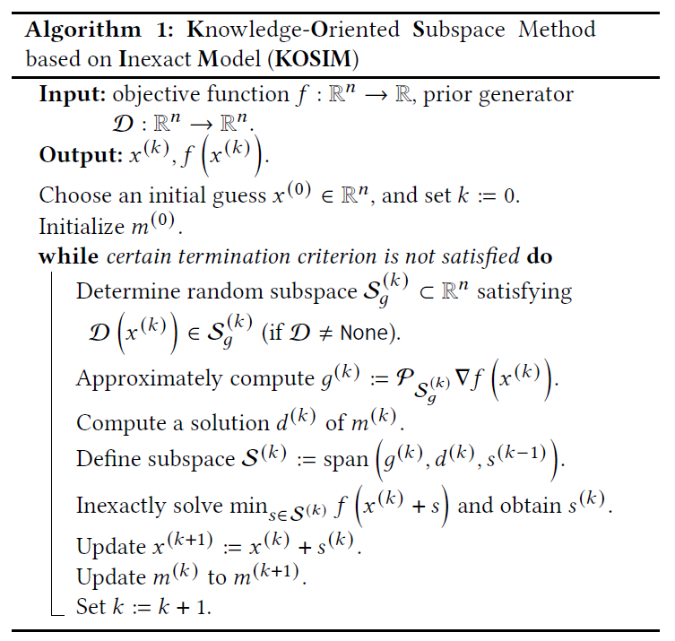
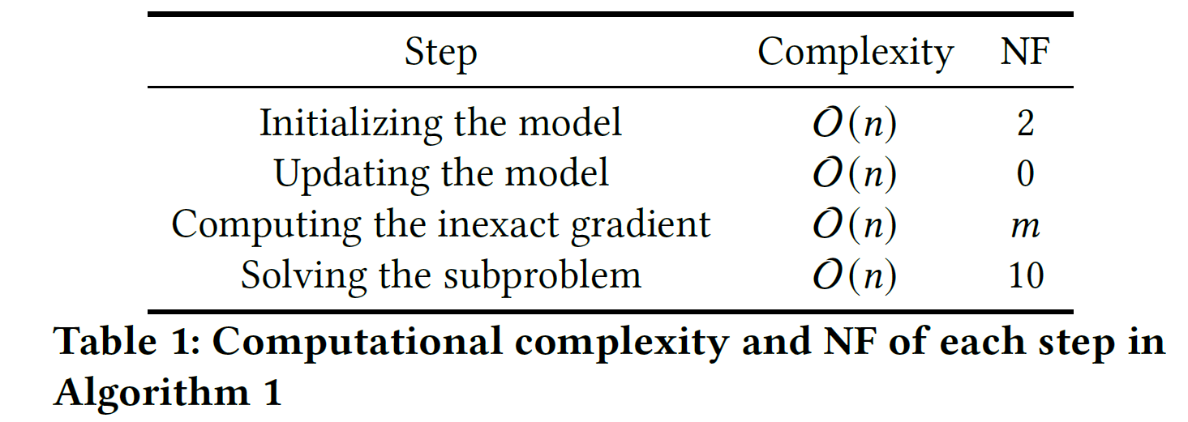
Algorithm - Detail
Notes:
連接上一個投影片

Slide 25
Outline
Introduction
Preliminaries
Algorithm
Experimental Result
Conclusion

Slide 26
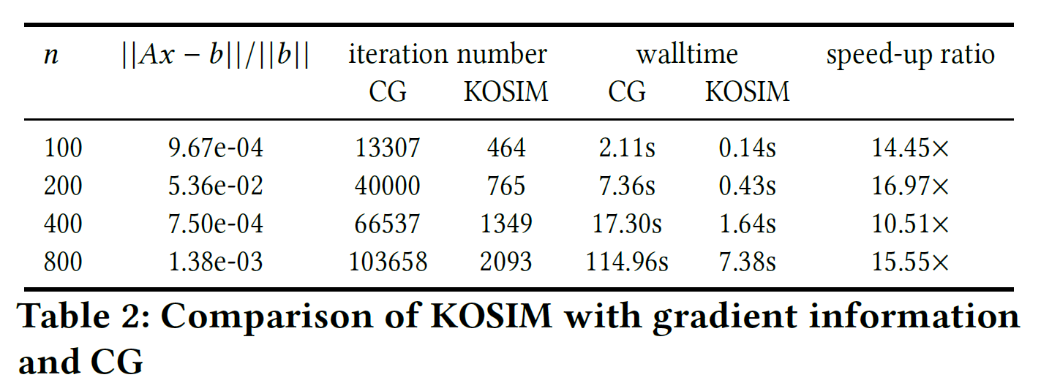
Experimental Result - Gradient
All codes are implemented in C, and packed as a Python interface.
All the tests of KOSIM were performed on a Lenovo ST8810 cluster.
Notes:
比較gradient的部分
從Table 2的結果中，我們可以觀察到KOSIM中的二次模型明顯加速了算法。

Slide 27
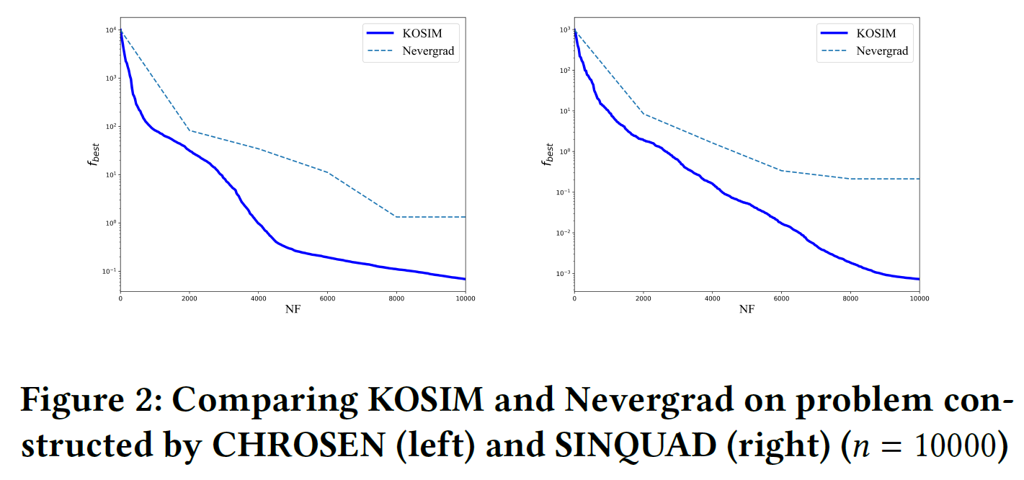
Experimental Result - DFO
Notes:
比較DFO的部分

Slide 28
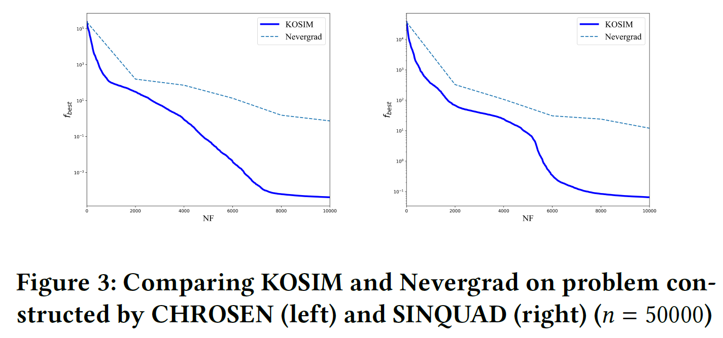
Experimental Result - DFO
Notes:
比較DFO的部分
我們可以清楚地觀察到KOSIM在這兩個問題上的效率優於Nevergrad。

Slide 29
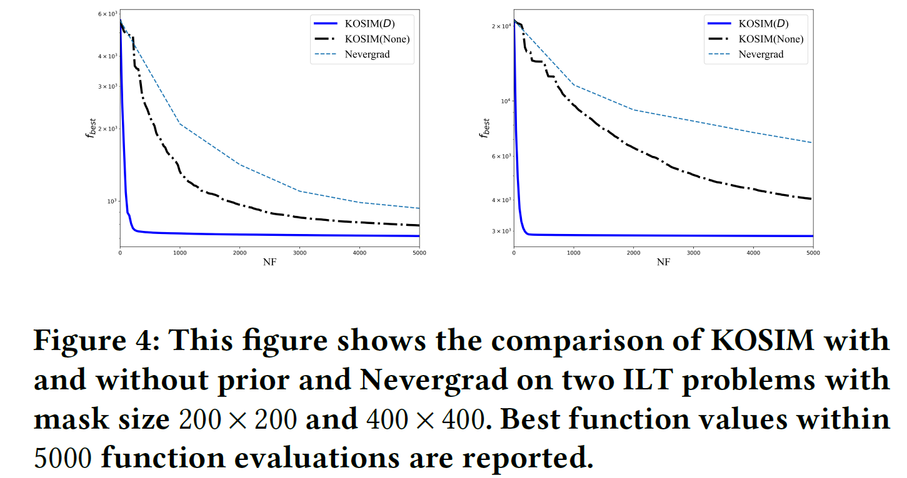

Experimental Result – Solve ILT
$N_{t}=50.$

Slide 30
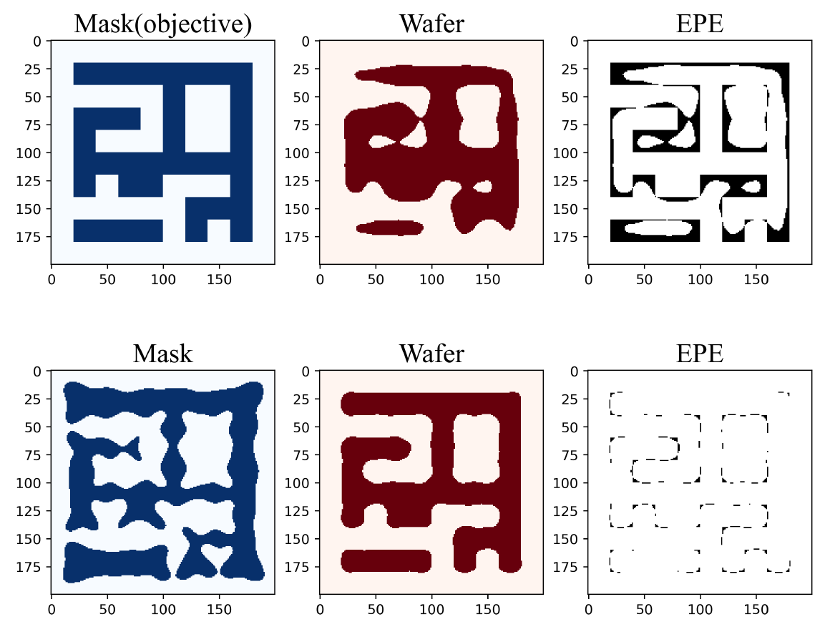

Experimental Result – Solve ILT
Mask size = $200 ×200$

Slide 31
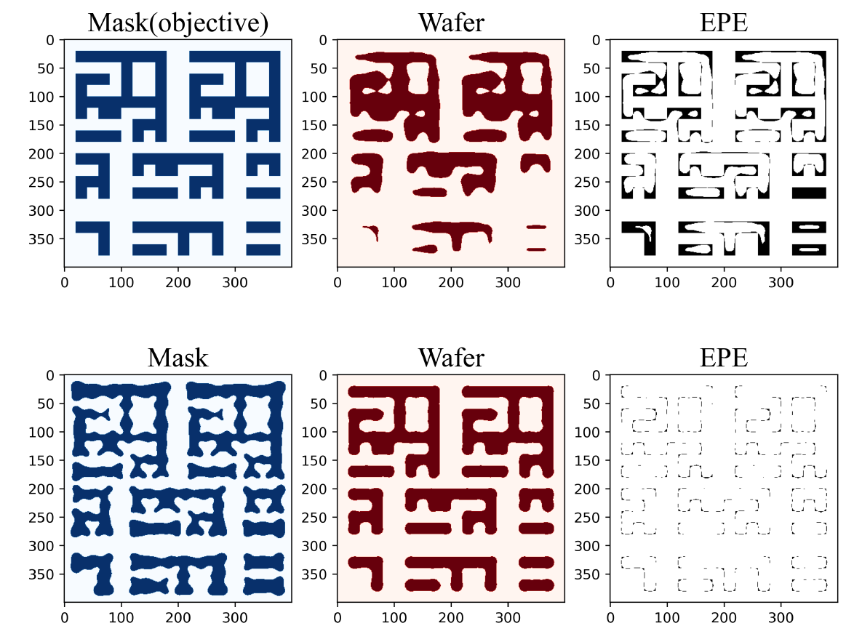

Experimental Result – Solve ILT
Mask size = $400 ×400$

Slide 32

Experimental Result – Solve ILT
Mask size = $1000 ×1000$
Notes:
KOSIM在500次函數評估內給出了對MASK的高精度校正。這是一個相當可觀的結果，因為問題的維度遠大於500。

Slide 33
Outline
Introduction
Preliminaries
Algorithm
Experimental Result
Conclusion

Slide 34
Conclusion
Several techniques are developed for KOSIM:
Knowledge-oriented inexact gradients.
Maintaining inexact models.
Constructing subspaces.
Solving the subproblems.
KOSIM evaluates only O(1) function values and has only O(𝑛) computational complexity per iteration.

Slide 35
Thank you for listening!

